Slide 1
Live Up !!!
TEAM MEMBERS
Shreyaa Sridhar ( 21 ) ,
Khushbu Shashikant Kolhe ( 9 ) ,
Geovanni Nicque West ( 23 ) ,
Naga Venkata Satya Pranoop Mutha ( 15 )

Slide 2
Motivation
Food choices that we make each day affect your health — how you feel today, tomorrow, and in the future. Good nutrition is an important part of leading a healthy lifestyle.
Combined with physical activity, your diet can help you to reach and maintain a healthy weight and promote your overall health.
This motivated us to select this topic to help people stay fit and healthy.

Slide 3
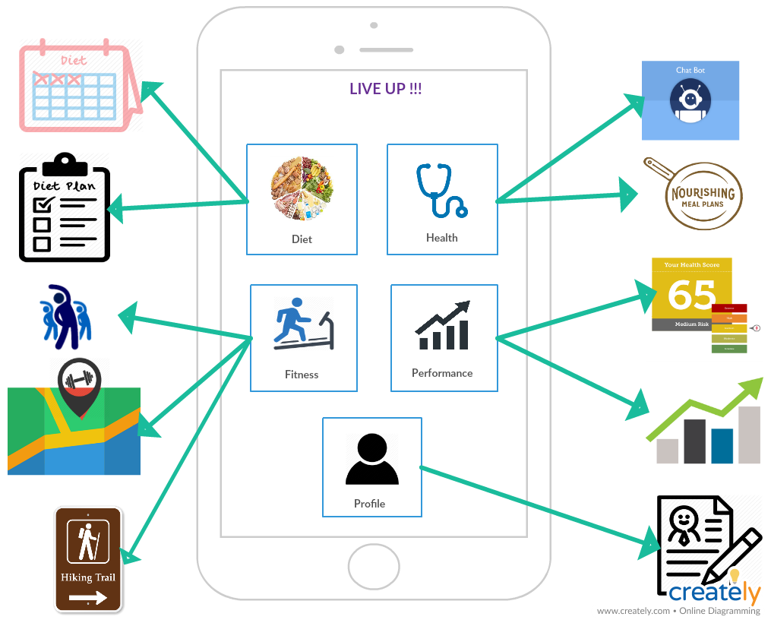
Features

Slide 4


